Slide 1

Investigating Drop in Ratings
BingHive

Slide 2
Problem statement
BingHive's ratings have dropped significantly since the release of an update two months ago.
Users have been reporting issues with the search functionality, such as errors and irrelevant results.

Slide 3
DATA
The data used in this investigation comes from two files:
users_activity_log.csv: This file contains activity logs of users, including the user ID, event type, name of event, time of action, OS, device, etc.
device_details.csv: This file contains device specifications, such as the device ID, name, screen size, OS version, RAM, battery, and chipset.

Slide 4
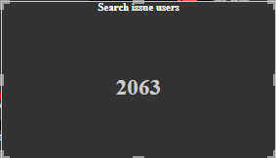
PROBLEM:1
The number of users who are experiencing issues with the search functionality.
The number of users who have experienced each type of issue, such as errors, no results, or irrelevant results.
Approximately 33.81% of BingHive users are experiencing issues with the search functionality.

Slide 5
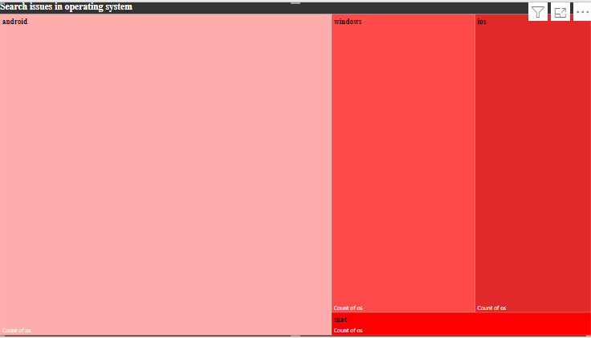
PROBLEM:2
The type of devices that are affected by the issue.
The issue is affecting users on all devices, android users are 194509, window users are 80358, ios users are 64923, and mac users are 11027.

Slide 6
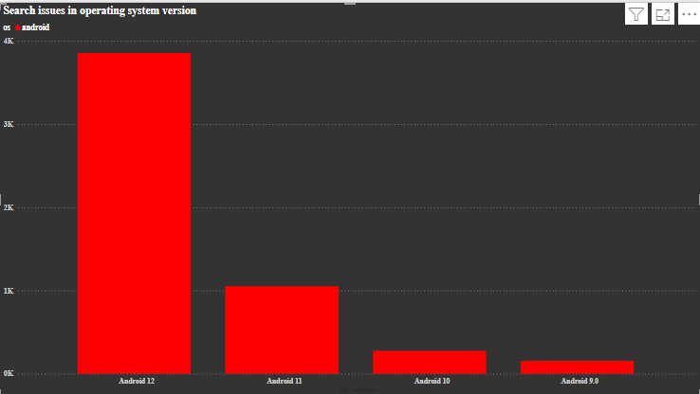
PROBLEM:3
The Operating System versions that are affected by the issue.
Problems found across all OS and their versions.
The max problems found are occurring on versions Android 12

Slide 7
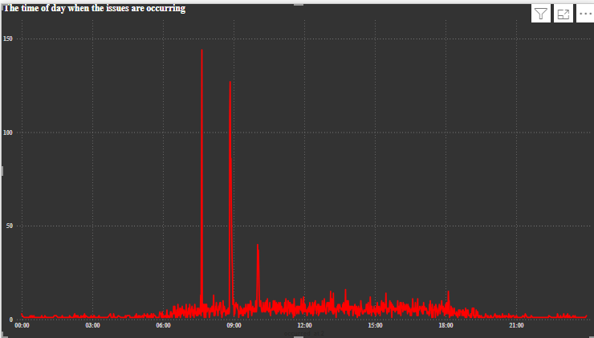
PROBLEM:4
The time of day when the issues are occurring.
The issues are occurring most frequently in evening hours from 7:00 to 9:00, when BingHive traffic is at its highest.

Slide 8
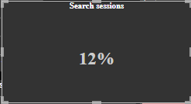
PROBLEM:5
In what percent of sessions is search being used?
Search is being used in a low percentage of sessions.

Slide 9
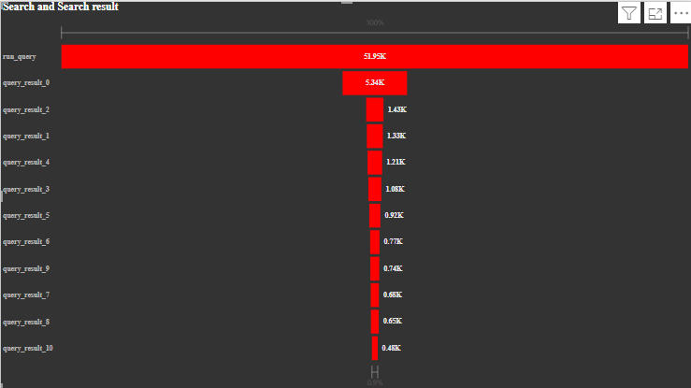
PROBLEM:6
Are users able to search at all? Is the search button working fine? and Do users face any errors after running a search query?
No, users are not able to search at all and the search button is not working fine, approximately 10.27% of users face errors after running a search query.

Slide 10
PROBLEM:7
Are users able to find what they search for? Does the ordering algorithm of search results need tuning?
In 28.11% of cases, users are not able to find what they search for. Yes, the ordering algorithm of search results needs tuning. In 17.84% cases(many cases), users have to scroll to the bottom of the page to find what they are looking for.

Slide 11
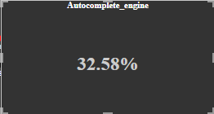
PROBLEM:8
Are the autocomplete suggestions helpful for users?
The autocomplete engine value is low, then it means that users are often clicking on the autocomplete suggestions. This suggests that the autocomplete suggestions are not helpful for users.

Slide 12
Recommendations
Fix the errors in the search functionality.
Tune the ordering algorithm of search results.
Investigate why users are not able to find what they search for in a high percentage of sessions.

Slide 13
Conclusion
The issues with the search functionality are likely causing the drop in Bing Hive's ratings. By fixing the errors, tuning the ordering algorithm, and investigating why users are not able to find what they search for, Bing Hive can improve the search functionality and regain the trust of its users.

